Slide 1
K-means Clustering

Slide 2
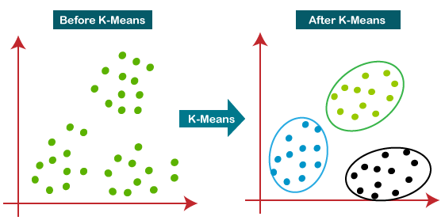
What is K-means Algorithm?
Unsupervised learning algorithm
Centroid-based algorithm
Input: unlabeled dataset & K-number of clusters

Slide 3


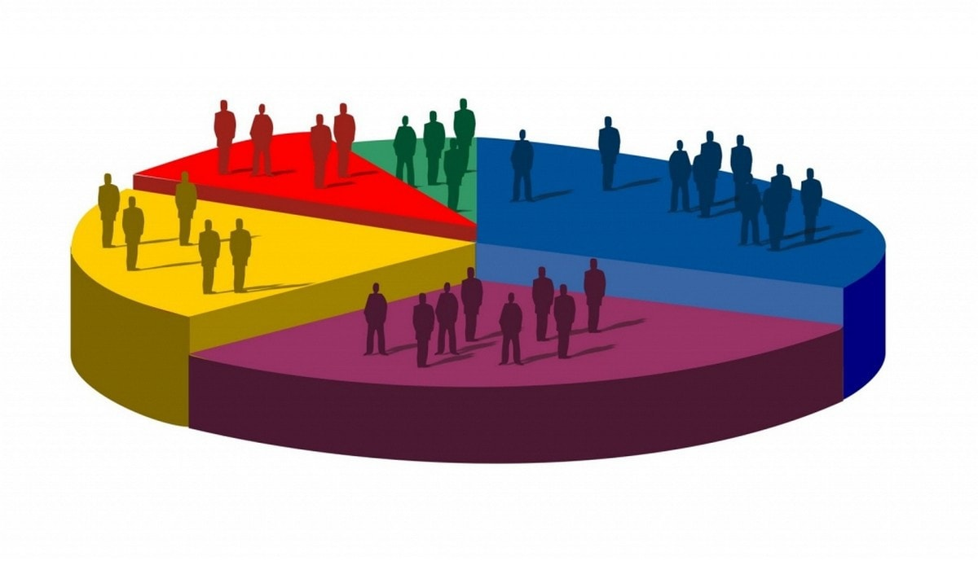
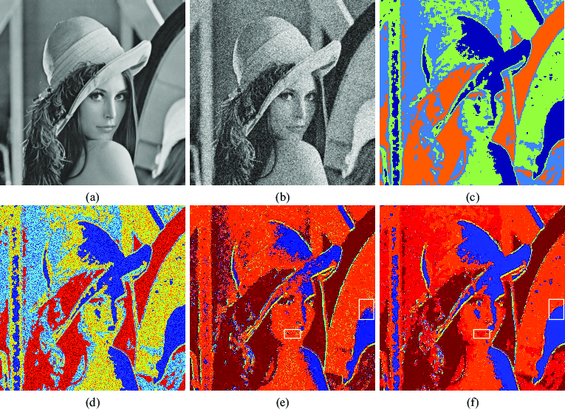
K-means application
Categorize music
Social network analysis
Market segmentation
Image Segmentation

Slide 4
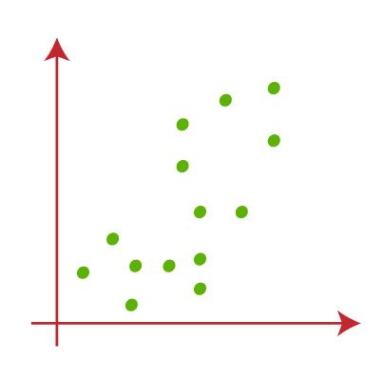
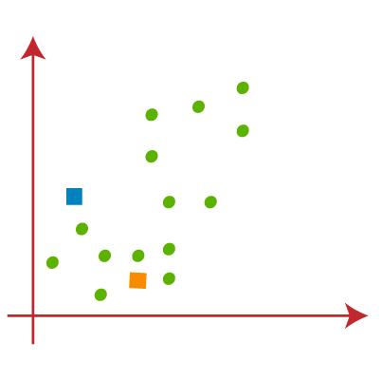
How does K-means algorithm work?
Step1: Select K number
Step2: Select random K points

Slide 5
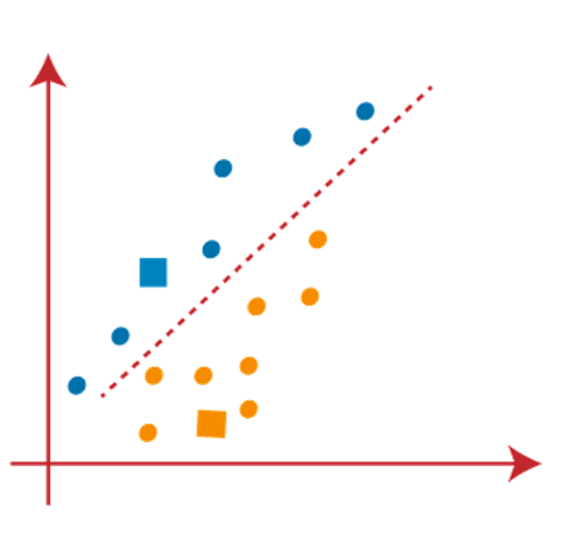
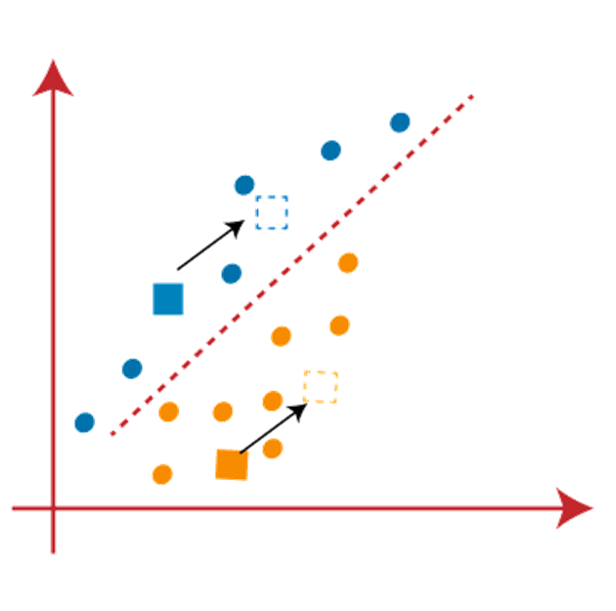
How does K-means algorithm work?
Step3: Assign each data point to closest centroid
Step4: Recaculate the centroid and place a new centroid

Slide 6
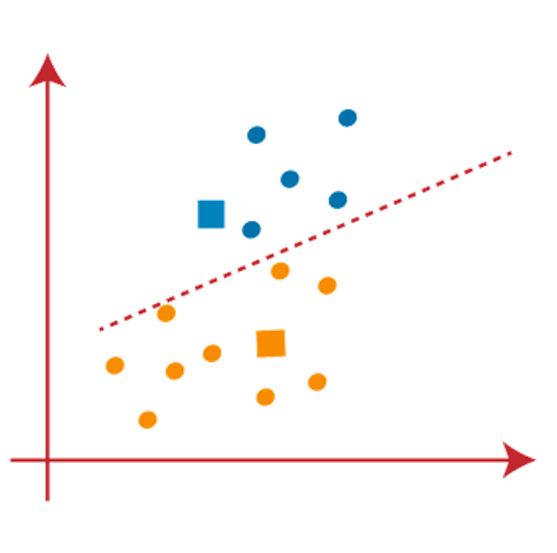
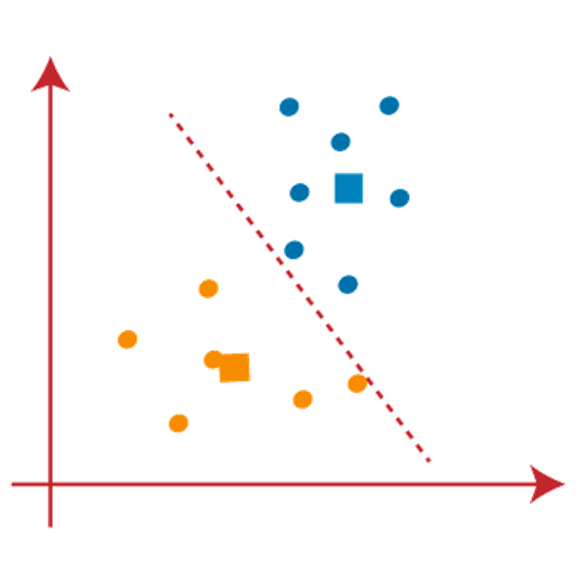
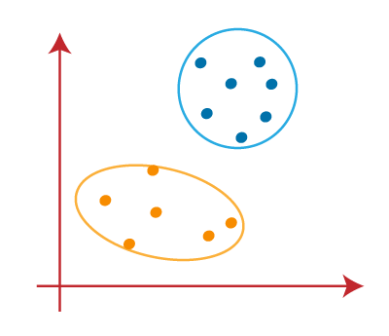
How does K-means algorithm work?
Repeat Step3-4 until no data point is changed

Slide 7
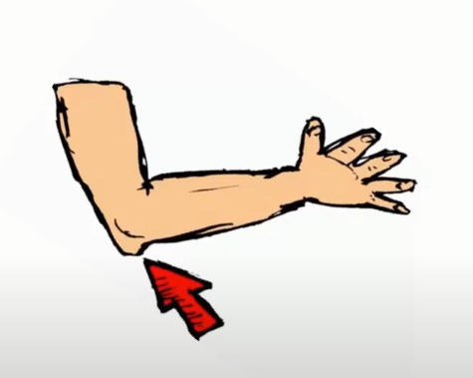

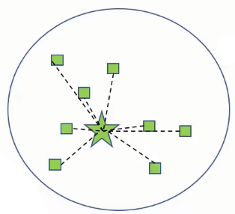
Choosing the “K number of clusters”
Elbow method
∑_{Pi in Cluster1} distance(Pi C1)2: It is the sum of the square of the distances between each data point and its centroid within a cluster1 and the same for the other two terms.

Slide 8
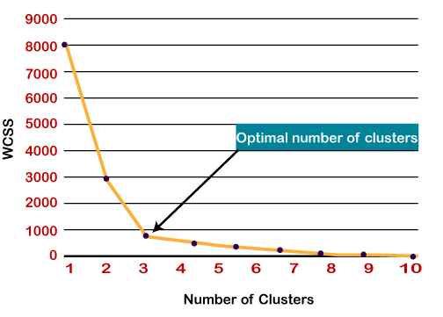
Choosing the “K number of clusters”
Elbow method

Slide 9
PROS and CONS of K-Means
Advantages
. Simple
. Spherical clusters
. Suit in a large dataset
Disadvantages
. Choose K manually
. Scaling with number of dimensions
.Clustering data of varying sizes and density

